Slide 1
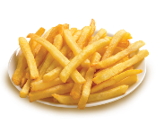
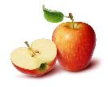
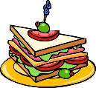
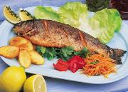
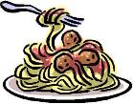
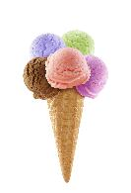
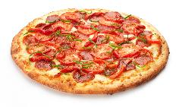
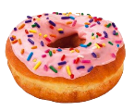
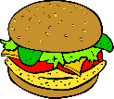
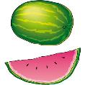
What is your favorite food?
My favorite food is_______.

Slide 2
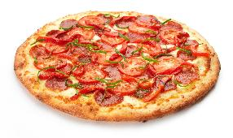
What is your favorite food?
My favorite food is_______.

Slide 3
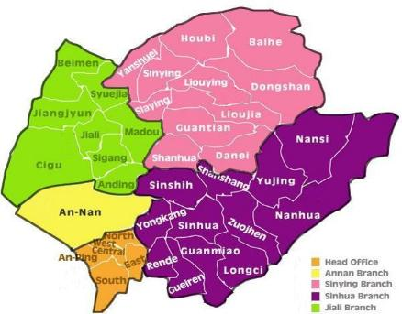
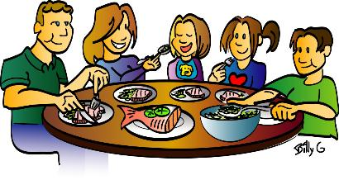
Food in Tainan

Slide 4
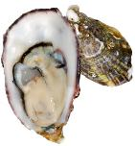
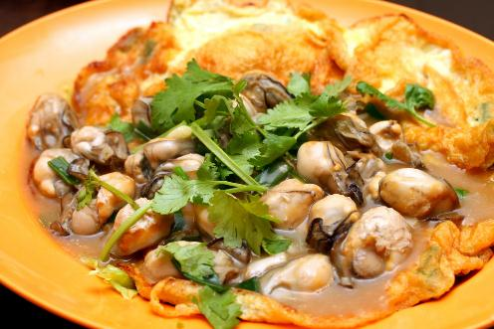
oyster pancake
egg
oysters
vegetables

Slide 5
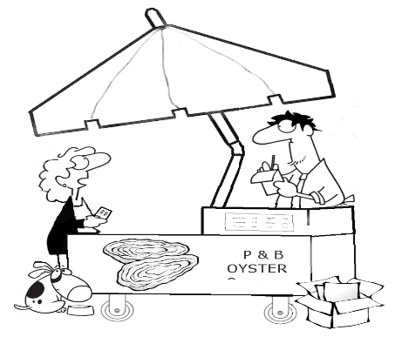
It is oyster pancake.
What is it?

Slide 6
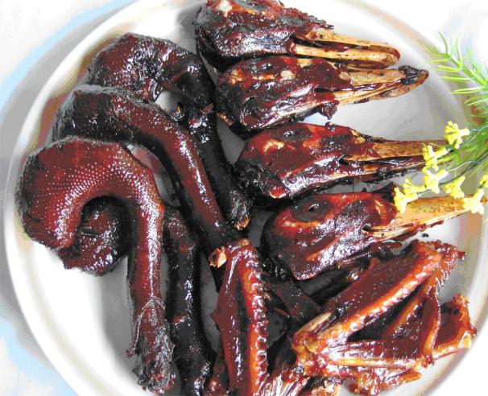
duck head
duck head
sweet skin

Slide 7
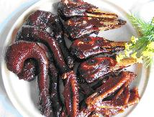
It is duck head.
What is it?

Slide 8
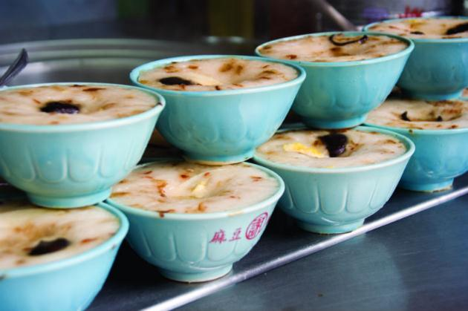
rice pudding
rice
meat
egg

Slide 9
It is rice pudding.
What is it?

Slide 10
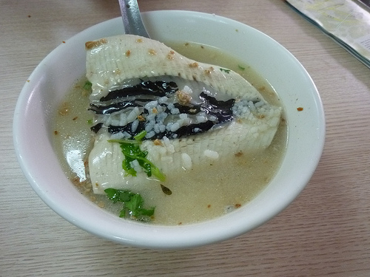
milkfish
milkfish
rice
soup

Slide 11
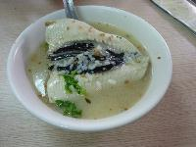
It is milkfish.
What is it?

Slide 12
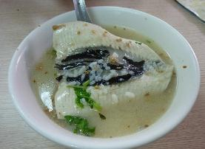
What is it?
It is_____.
oyster pancake
rice pudding
duck head
milkfish

Slide 13
What is it?
It is_____.

Slide 14
milkfish

Slide 15
oyster pancake

Slide 16
rice pudding

Slide 17
duck head

Slide 18
milkfish

Slide 19
oyster pancake

Slide 20
duck head

Slide 21
milkfish

Slide 22
rice pudding

Slide 23
duck head

Slide 24
rice pudding

Slide 25
oyster pancake

Slide 26
What is it?
It is _____.
One, please!
Here you are.
It’s yummy! Thank you!
Goodbye!

Slide 27
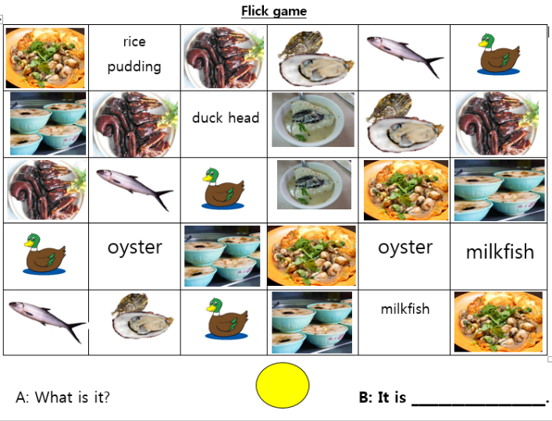

Slide 28
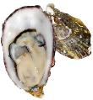
What is it?
It is_____.
oyster pancake
rice pudding
milkfish
duck head

Slide 31
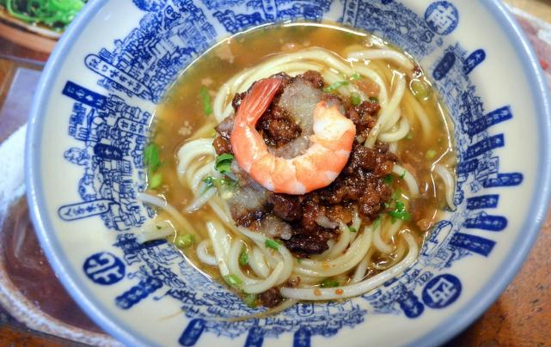
Danzai noodles
shrimp
pork
noodles

Slide 32
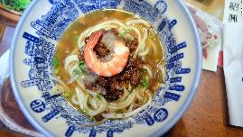
It is danzai noodles.
What is it?

Slide 33
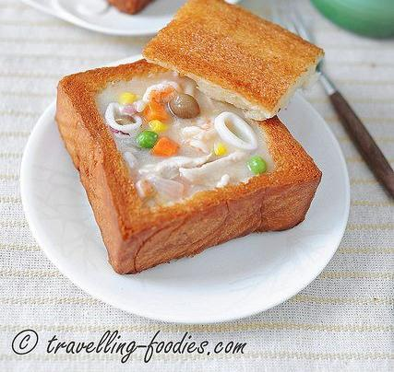
Coffin bread
bread
seafood
soup

Slide 34
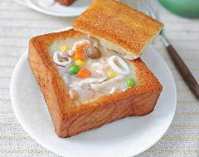
It is coffin bread.
What is it?

Slide 35
What’s good to eat in Tainan?

