Slide 2
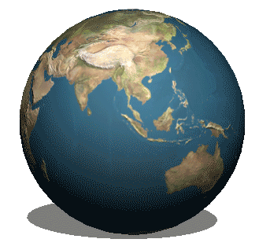
The
Earth
地球

Slide 3
Earth
陸地；地面，地上，土，泥

Slide 4
qu
ake
顫抖，哆嗦

Slide 5
earth
quake
?

Slide 8
I can’t see!
Help!

Slide 9
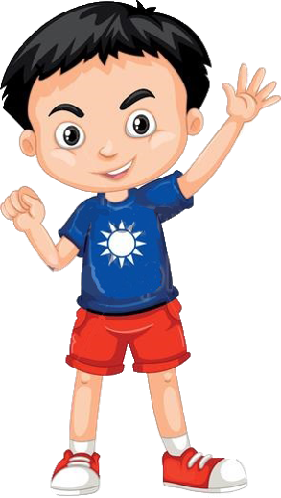
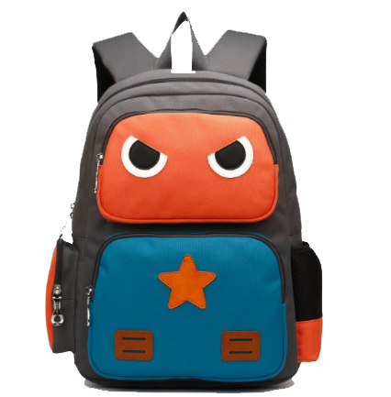
It is my go bag.
What is that?

Slide 10
go bag

Slide 11
Is it a school bag?

Slide 12
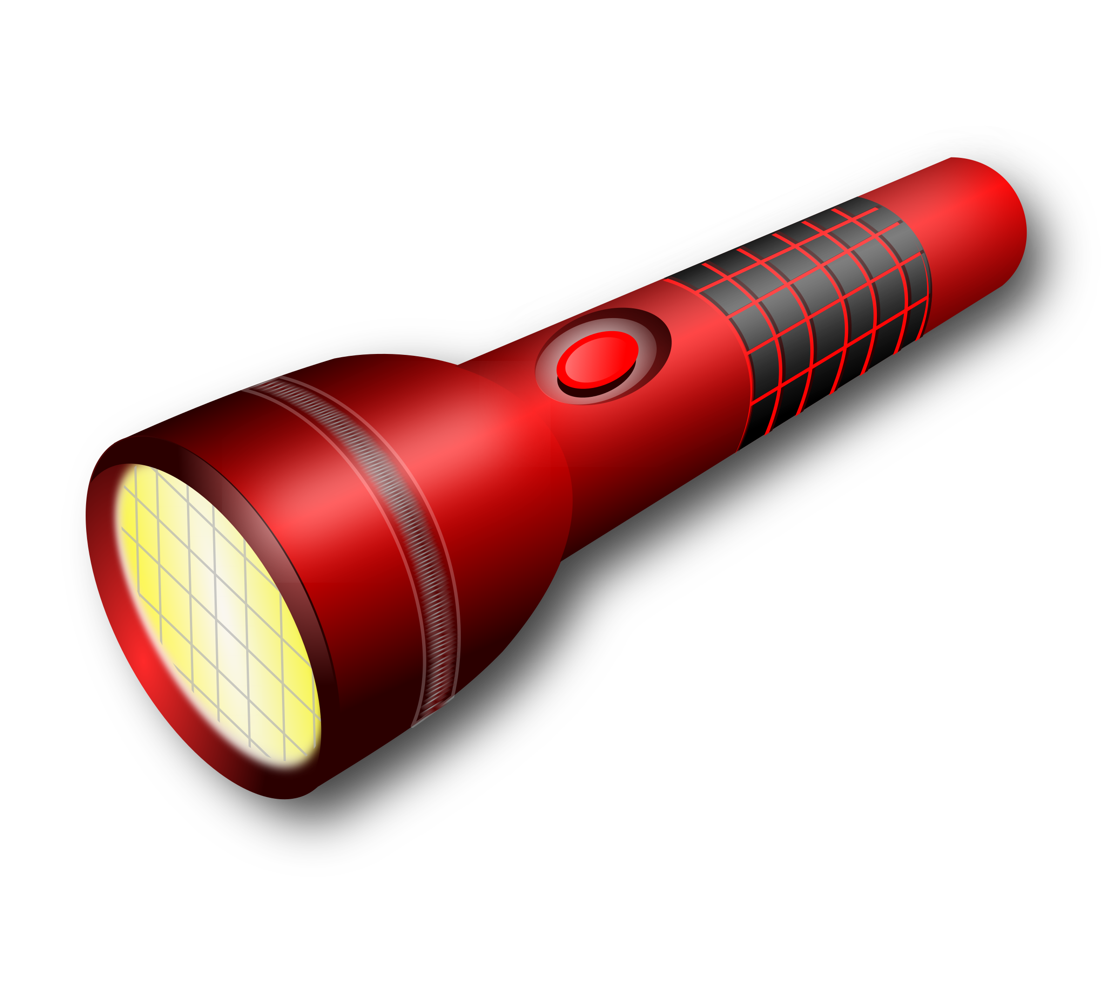
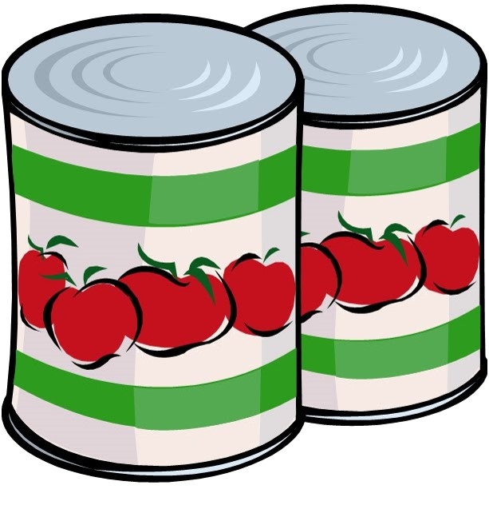
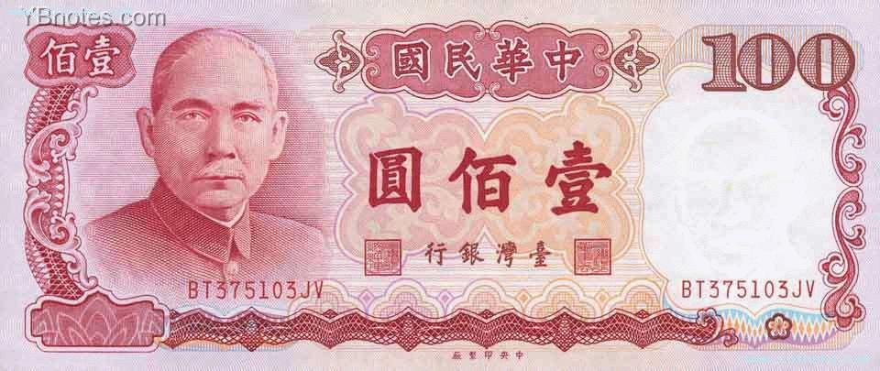
It’s a go bag!

Slide 13
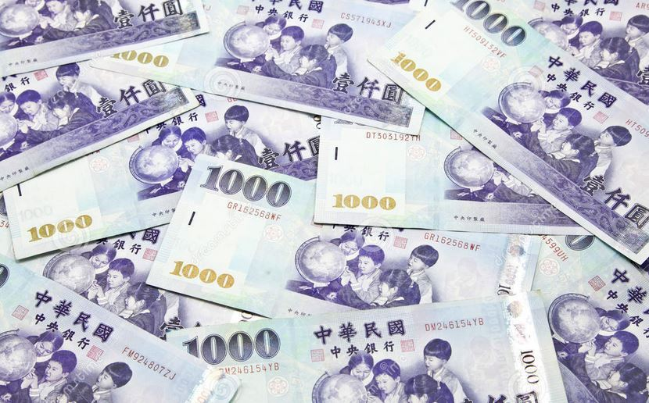
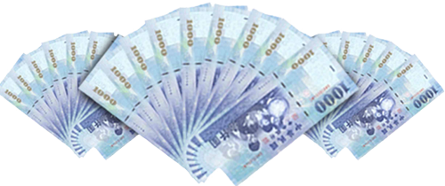
money

Slide 14
Does money go in the bag?

Slide 15
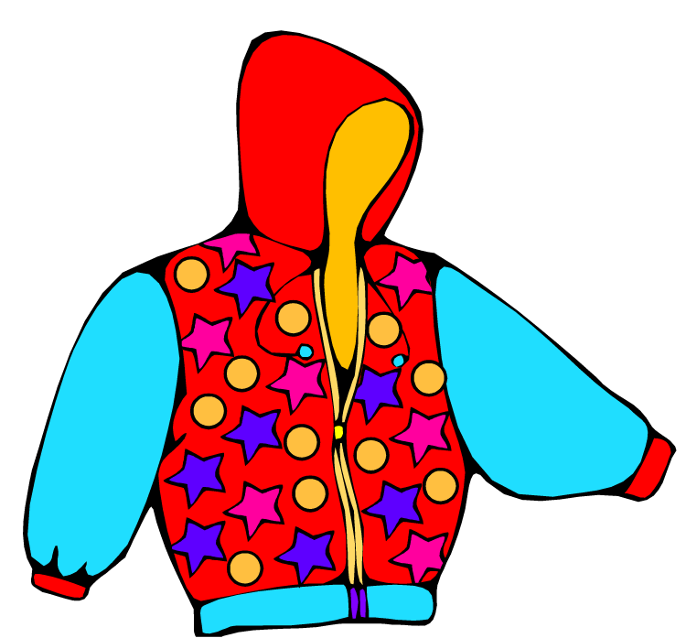
a jacket

Slide 16
Does a jacket go in the bag?

Slide 17
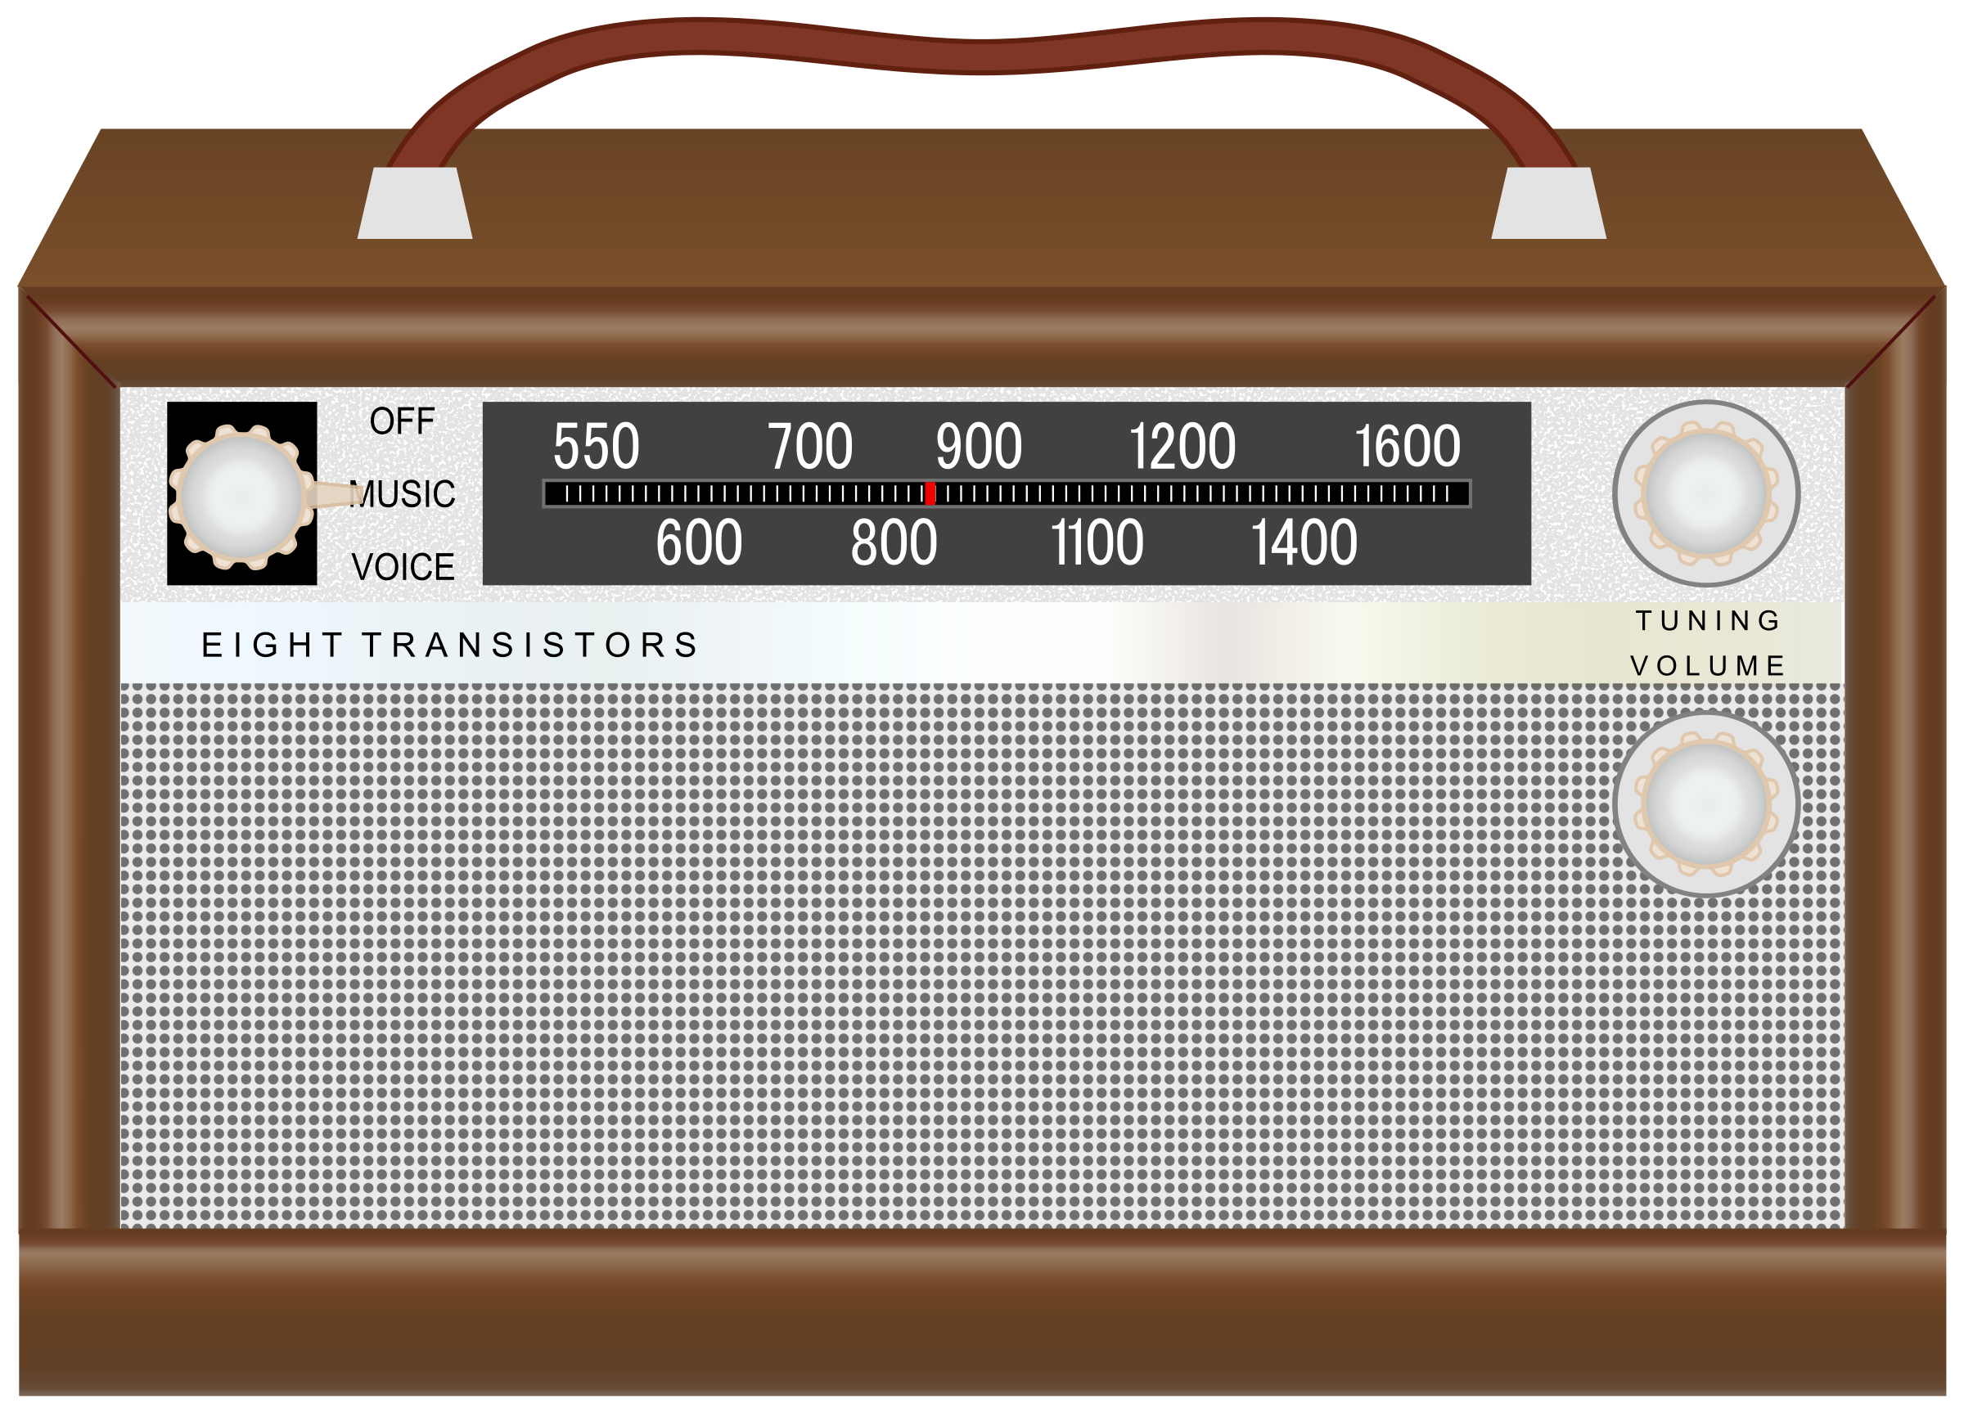
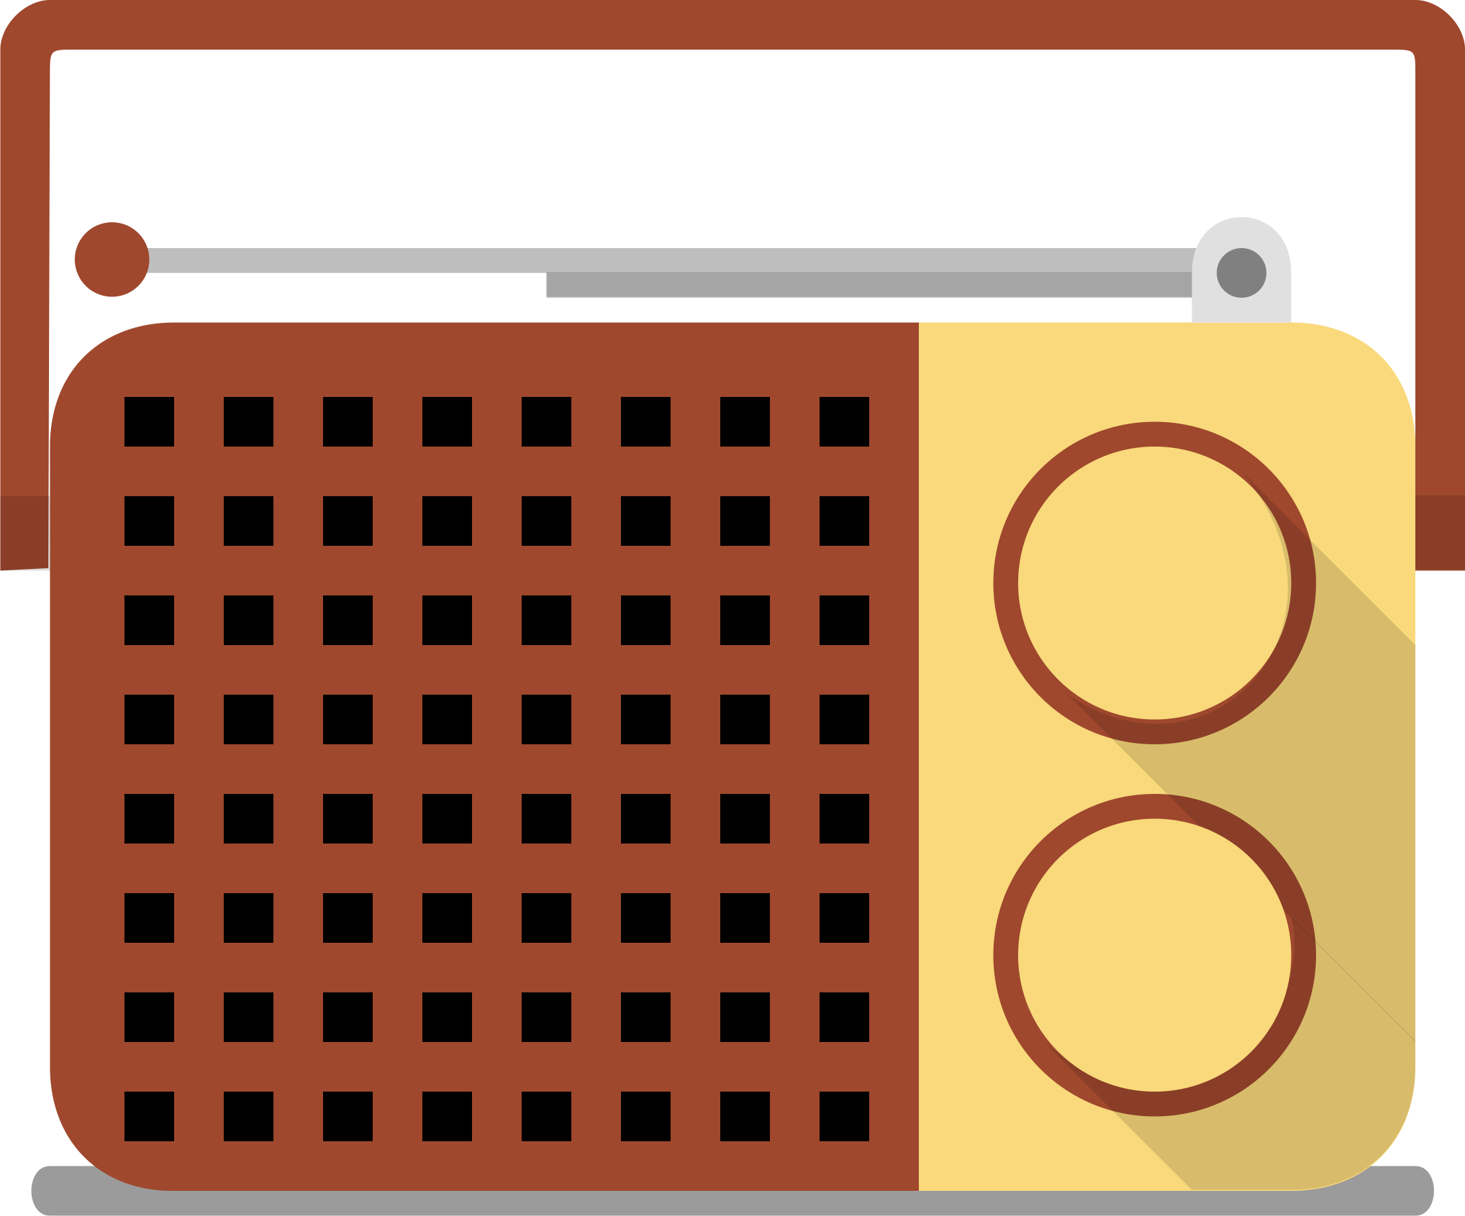
a radio

Slide 18
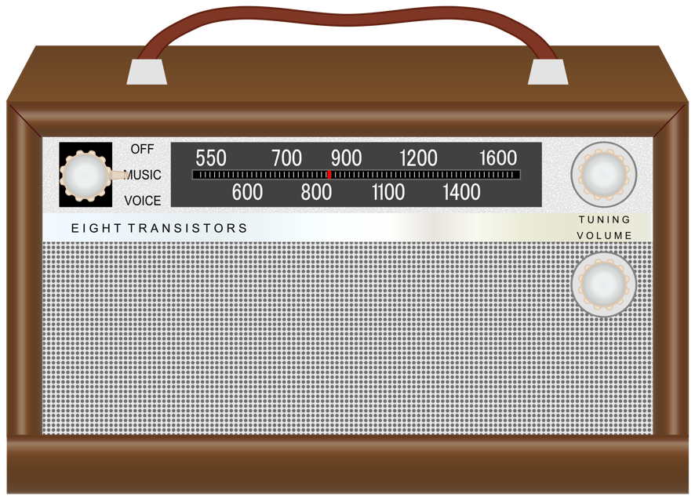
Does a radio go in the bag?

Slide 19
water

Slide 20
Does water go in the bag?

Slide 21
cookies

Slide 22
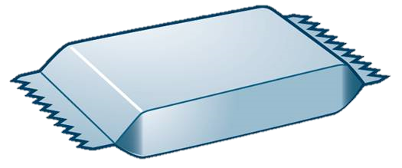
Do cookies go in the bag?

Slide 23
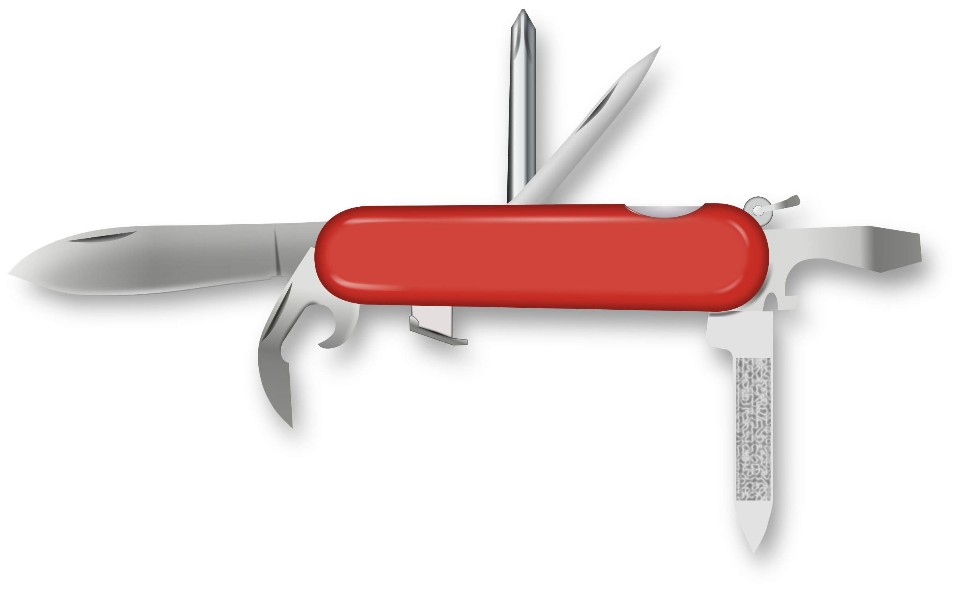
a knife

Slide 24
Does a knife go in the bag?

Slide 25
a flashlight

Slide 26
Does a flashlight go in the bag?

Slide 27
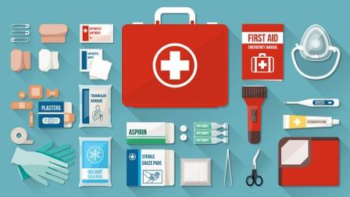
a first aid kit

Slide 28
Does a first aid kit go in the bag?

Slide 29
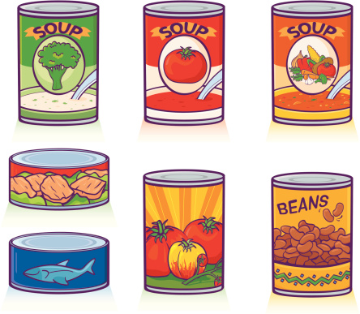
canned food

Slide 30
Does canned food go in the bag?

Slide 31
a radio
Does _______ go in the bag?
a knife
a jacket
water
cookies

Slide 32
